Slide 1





Team
NightWatch
Julian
Chris
Alfredo
Ryan
Luke
13 December 2018

Slide 2
PointMap
A Geospatial Mapping Tool

Slide 3
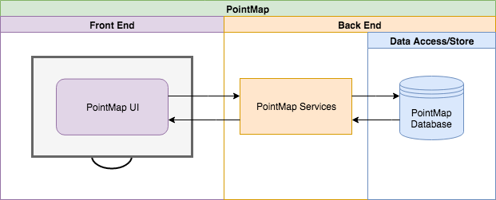
High Level Overview

Slide 4
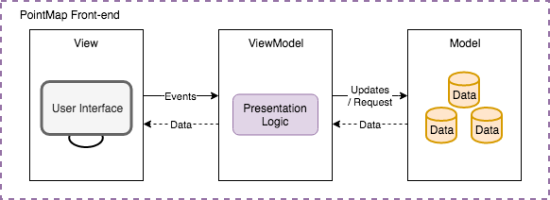
Front-End Architecture

Slide 5
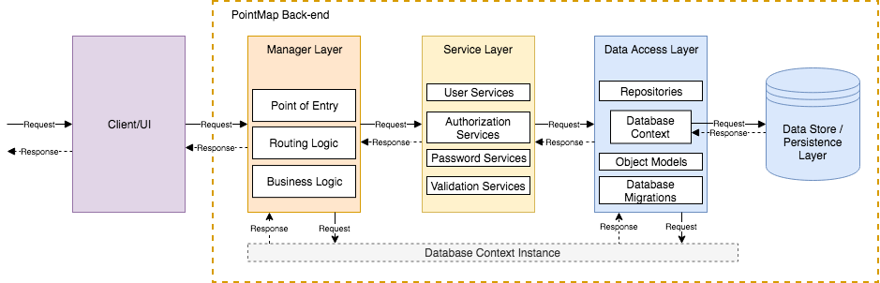
Back-End Architecture

Slide 6
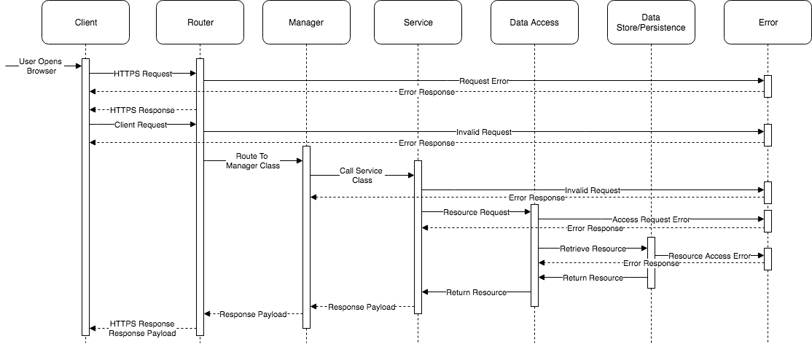
Abstraction Interaction

Slide 7
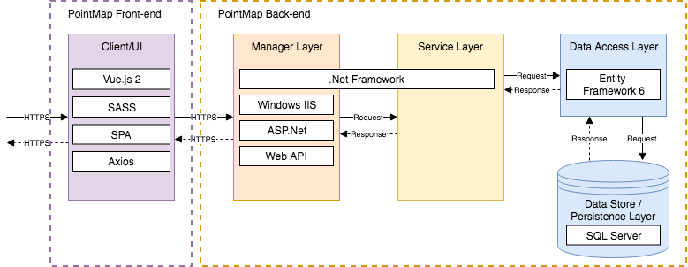
Technology Architecture

Slide 8
Authorization
Three Layers (Currently)
Claims
Management chain
Clients
Functionality
Toggle Client
Toggle Service
User Has Access To Service
User to User Authorization

Slide 9
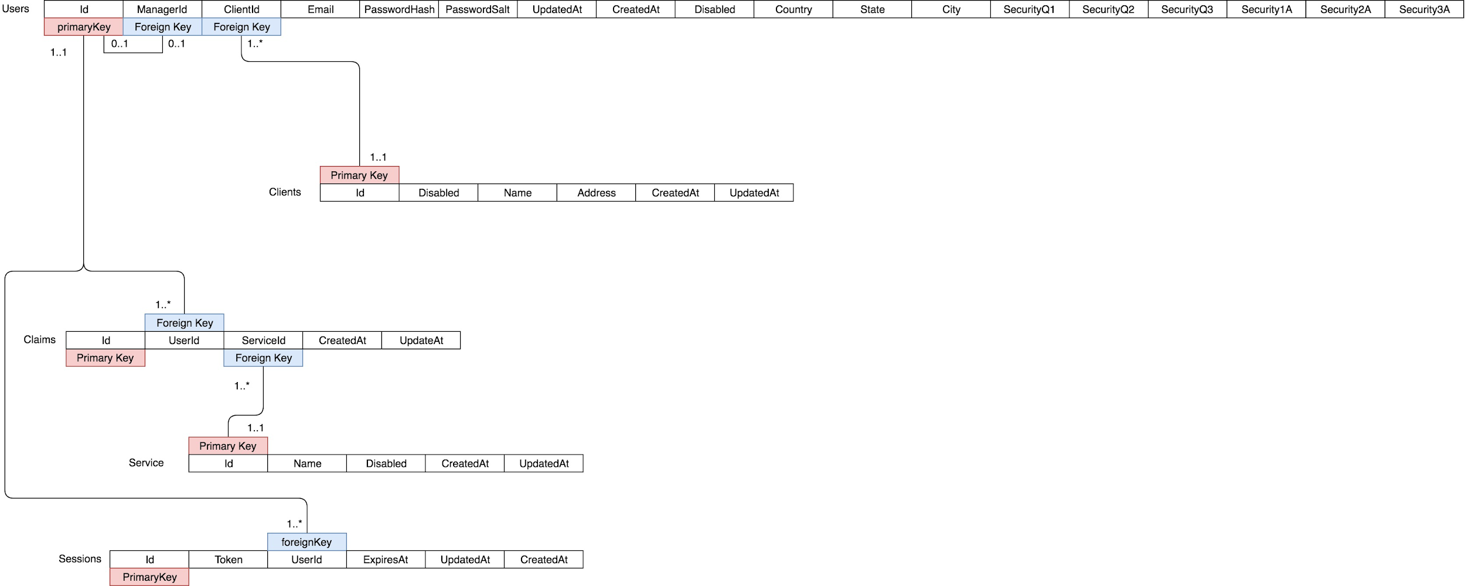
Database Layout

Slide 10
User Management
Manager
Services
Repositories

Slide 11
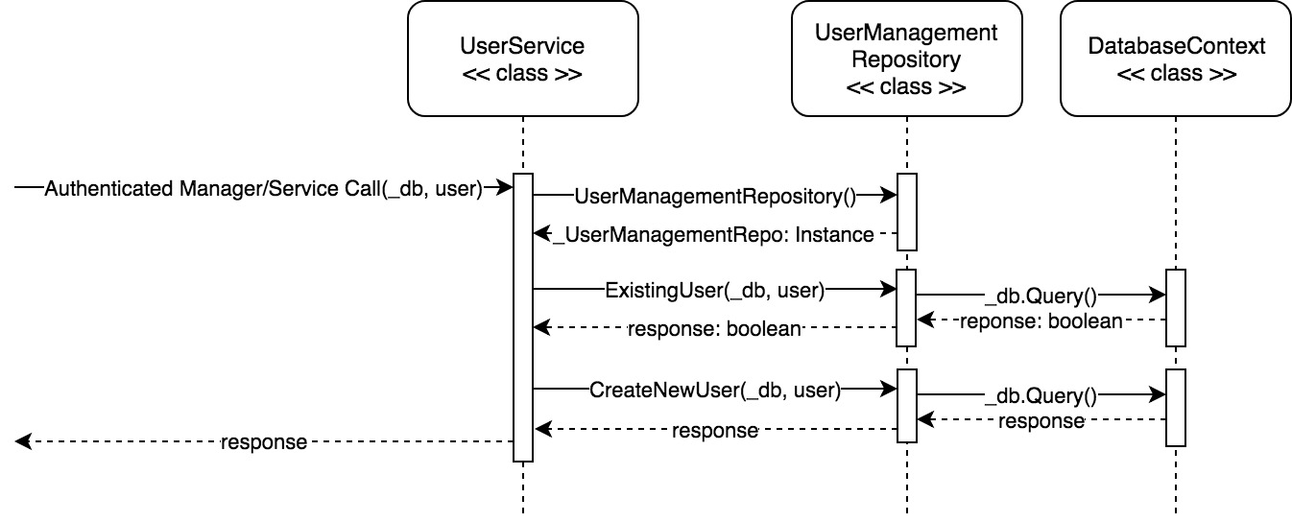
Example for Creating a User

Slide 12
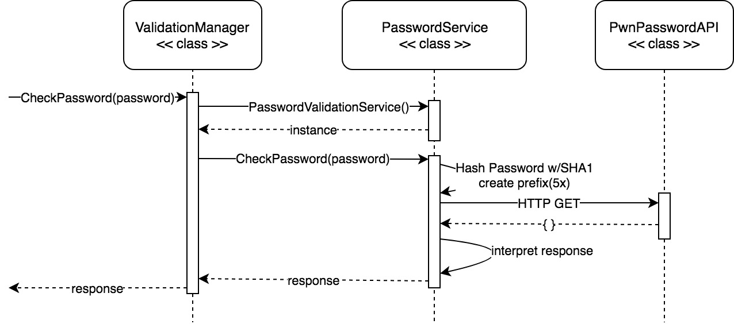
PwnPasswordAPI

